Slide 1
Battle of droids
(console game)

Slide 2
The game was developed by:
Dmytro Demkovych
Anton Avdiyevskyy
Yuriy Dmytryshyn

Slide 3


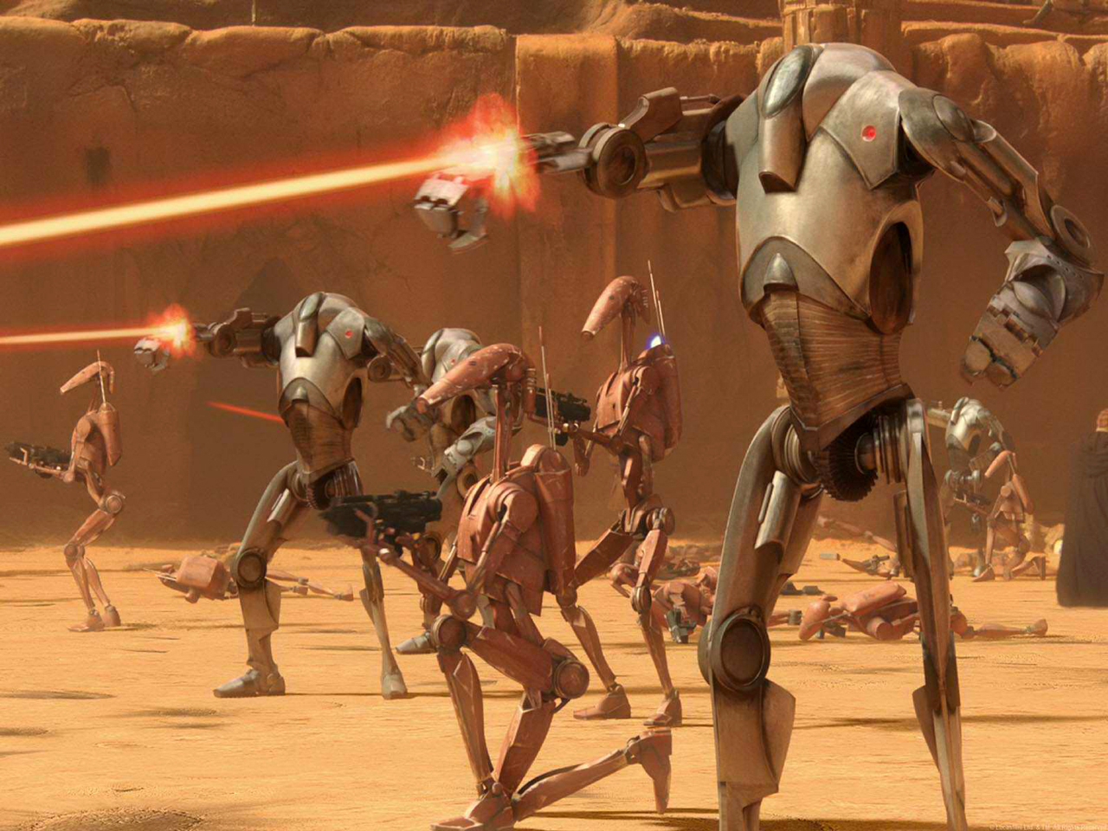

The game was created for people who want to kill their time and a few droids when they are boring.
5 minutes later

Slide 4
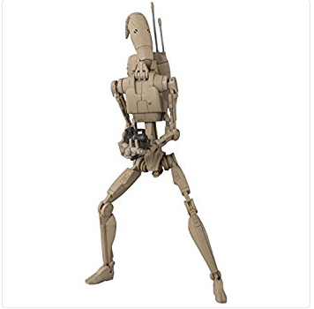
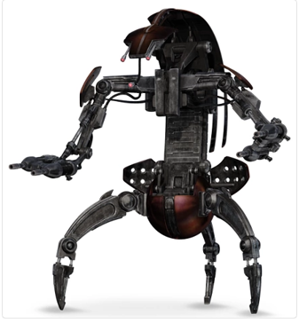
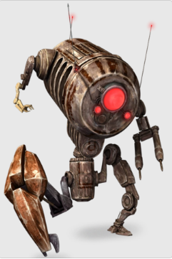
Main aim of this game is to kill droid which are managed by computer. Also to make this game more interesting our team give you an opportunity to have a list from 3 types of droids and choose one of them. Then you can create your own droid with unique name and chosen type.

Slide 5
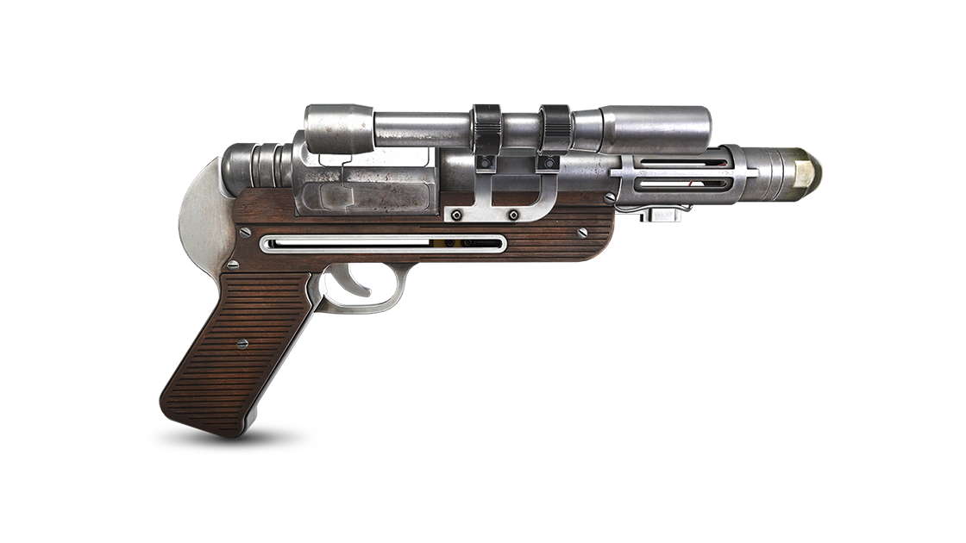
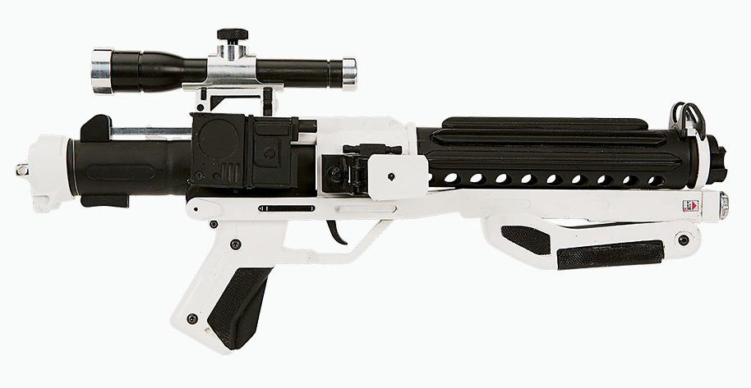

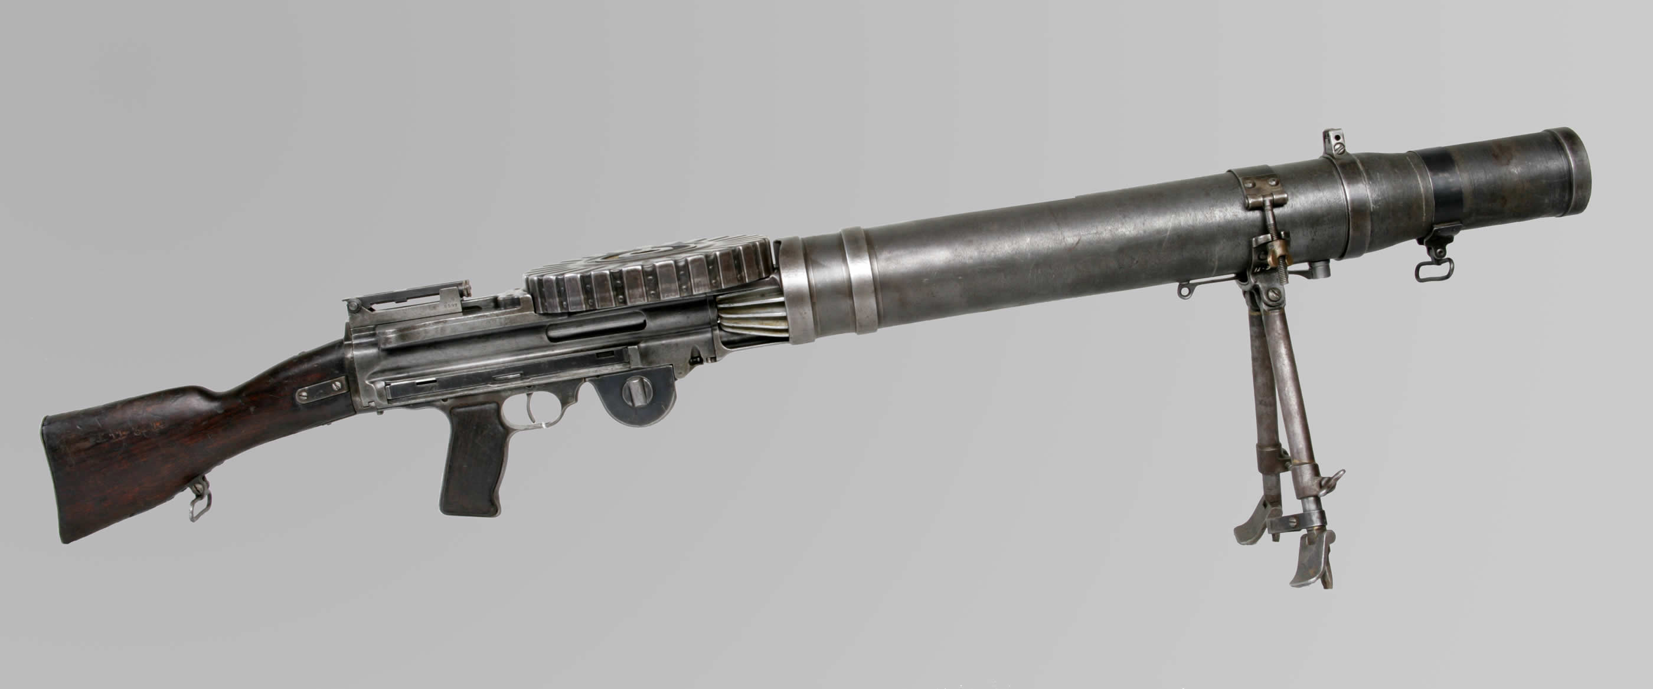
After choices of droids you have to pick one of three blaster. Each of them has different characteristics.

Slide 6






The game divided for levels, but if you want to move to a higher level, you should win.

Slide 7

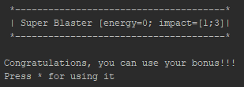

Also game have some surprises...
One of them is Super Blaster which you can use when your health is too bad...
It gives you a chance. A chance for win even if you can die after next hit of
your opponent…

Slide 8

if you are interested let's try to play and find out what else this game hides…

